Slide 1
MATLAB for Engineering Applications Fifth Edition
William J. Palm III
© McGraw Hill LLC. All rights reserved. No reproduction or distribution without the prior written consent of McGraw Hill LLC.

Slide 2
Chapter 07
Statistics, Probability, and Interpolation

Slide 3
Statistics and Histograms
MATLAB provides the mean(x), mode(x), and median(x) functions to compute the mean, mode, and median of the data values stored in x, if x is a vector.
If x is a matrix, a row vector is returned containing the mean (or mode or median) value of each column of x.
A histogram is a plot of the frequency of occurrence of data values versus the values themselves. To plot a histogram, the data must be grouped into subranges, called bins.

Slide 4
Statistics and Histograms
MATLAB provides the histogram function to generate a histogram.
The basic form is histogram(y), where y is a vector containing the data. A uniform width is automatically chosen to reveal the underlying distribution.
The second form is histogram(y, n), where n is a user-specified scalar indicating the number of bins.
Unshaded rectangles can be obtained by using the syntax histogram(y, 'FaceColor’, 'none').

Slide 5
Breaking Strength of Thread
To ensure proper quality control, a thread manufacturer selects samples and tests them for breaking strength. Suppose that 20 thread samples are pulled until they break, and the breaking force is measured in newtons rounded off to integer values. The breaking force values recorded were 92, 94, 93, 96, 93, 94, 95, 96, 91, 93, 95, 95, 95, 92, 93, 94, 91, 94, 92, and 93. Plot the histogram of the data
% Thread breaking strength data for 20 tests.
y = [92,94,93,96,93,94,95,96,91,93,...
95,95,95,92,93,94,91,94,92,93];
histogram(y,‘FaceColor’,‘none’),...
axis([90 97 0 6]),...
ylabel(‘Absolute Frequency’),...
xlabel(‘Thread Strength (N)’),...
title(‘Absolute Frequency Histogram for 20 Tests’)
This creates the next figure.

Slide 6
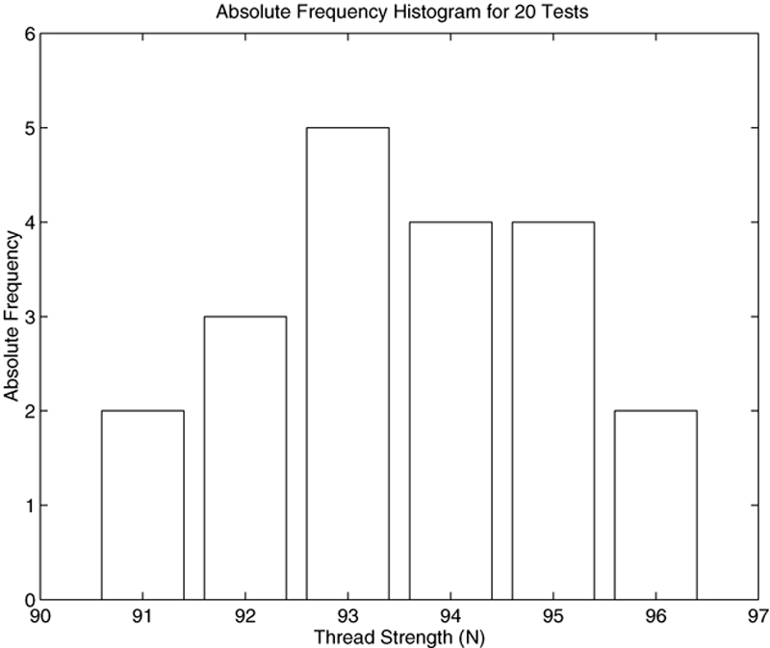
Histograms for 20 Tests of Thread Strength

Slide 7
Aggregating the Data
Rather than typing in a lot of data, sometimes we can aggregate them. For example,
% Thread strength data for 100 tests.
y = [91*ones(1,13),92*ones(1,15),93*ones(1,22),... 94*ones(1,19),95*ones(1,17),96*ones(1,14)];
histogram(y,‘FaceColor’,‘none’),…
ylabel(‘Absolute Frequency’),...
xlabel(‘Thread Strength (N)’),...
title(‘Absolute Frequency Histogram for 100 Tests’);
See the next slide.

Slide 8
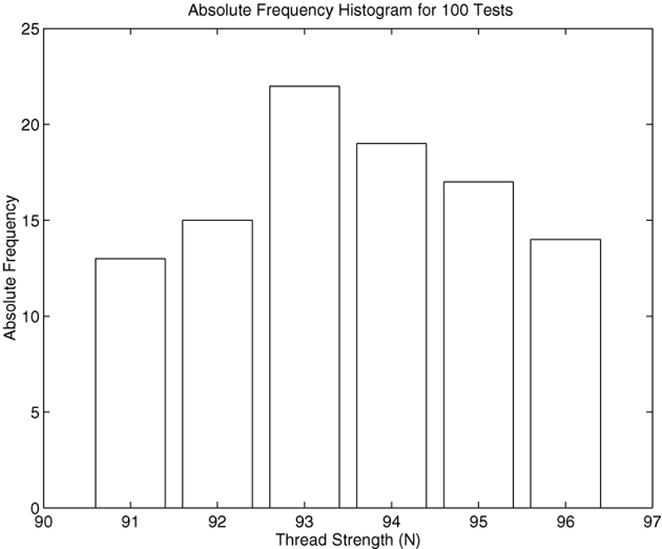
Absolute Frequency Histogram for 100 Thread Tests

Slide 9
Use of the bar Function for Relative Frequency Histograms
% Relative frequency histogram using ...
the bar function.
tests = 100;
y = [13,15,22,19,17,14]/tests;
x = [91:96];
bar(x,y),ylabel(‘Relative Frequency’),...
xlabel(‘Thread Strength (N)’),...
title(‘Relative Frequency Histogram ...
for 100 Tests’)
This creates the next figure.

Slide 10
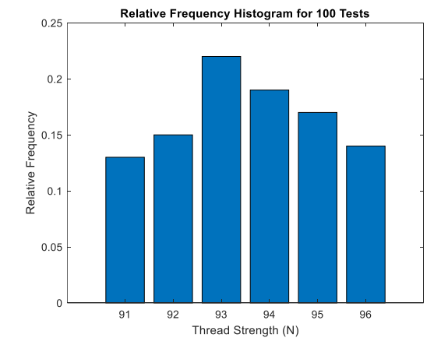
Relative frequency histogram for 100 thread tests

Slide 11
Histogram Functions
Command | Description
bar(x,y) | Creates a bar chart of y versus x using the default color scheme.
bar(x,y,‘w’) | Creates a bar chart of y versus x using unshaded rectangles.
histogram(y) | Aggregates the data in the vector y into bins of uniform width between the minimum and maximum values in y, using the default color.
histogram(y,n) | Aggregates the data in the vector y into n bins of uniform width between the minimum and maximum values in y.
histogram(y,‘FaceColor’,‘w’) | Aggregates the data in the vector y into bins of uniform width between the minimum and maximum values in y, using unshaded (white) rectangles.

Slide 12
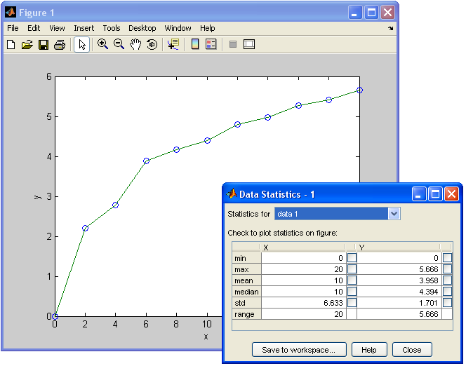
The Data Statistics Tool
With the Data Statistics tool you can calculate statistics for data and add plots of the statistics to a graph of the data. The tool is accessed from the Figure window after you plot the data. Click on the Tools menu, then select Data Statistics.
load census
x = cdate;
y = pop;
plot(x,y,'O’)

Slide 13
Scaled Frequency Histogram
Data can be plotted using either the absolute or relative frequencies, or by using data scaled so that the total area under the histogram's rectangles is 1. This scaled frequency histogram is the absolute frequency histogram divided by the total area of that histogram.
The area of each rectangle on the absolute frequency histogram equals the bin width times the absolute frequency for that bin. Because all the rectangles have the same width, the total area is the bin width times the sum of the absolute frequencies.

Slide 14
Scaled Frequency Histogram
% Absolute frequency data.
y_abs=[1,0,0,0,2,4,5,4,8,11,12,10,9,8,…
7,5,4,4,3,1,1,0,1];
binwidth = 0.5;
% Compute scaled frequency data.
area = binwidth*sum(y_abs);
y_scaled = y_abs/area;
% Define the bins.
bins = [64:binwidth:75];
% Plot the scaled histogram.
bar(bins,y_scaled),...
ylabel(‘Scaled Frequency’),…
xlabel(‘Height (in.)’)
This creates the next figure.

Slide 15
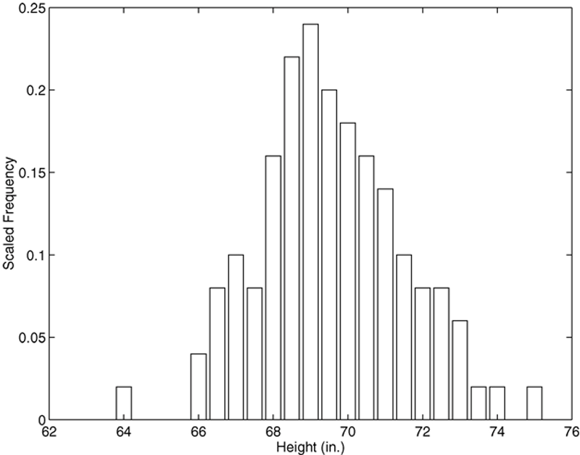
Scaled Histogram of Height Data

Slide 16
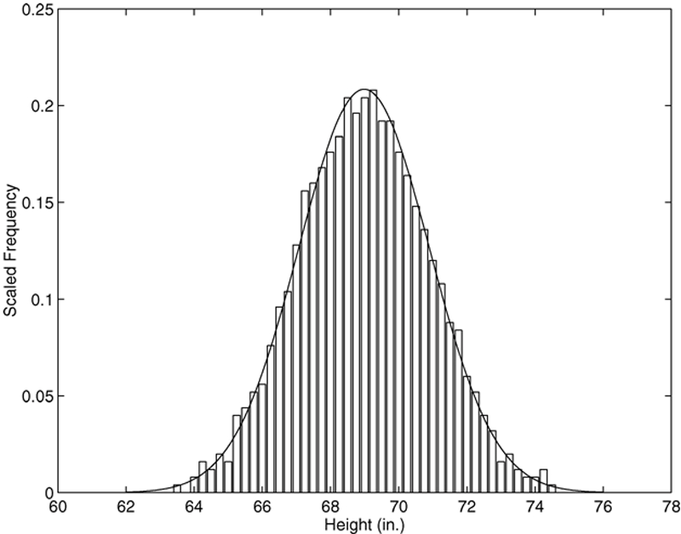
Scaled Histogram of Height Data for Very Many Measurements – Normally Distributed

Slide 17
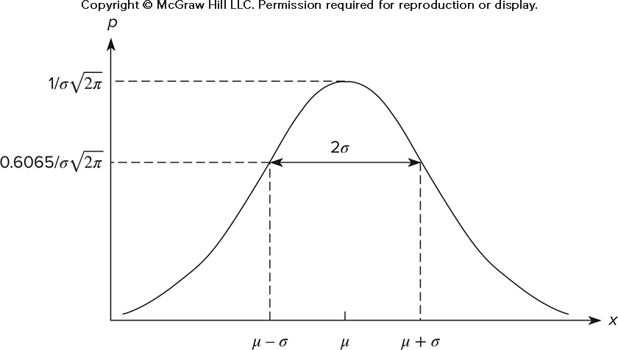

The Basic Shape of the Normal Distribution Curve

Slide 18
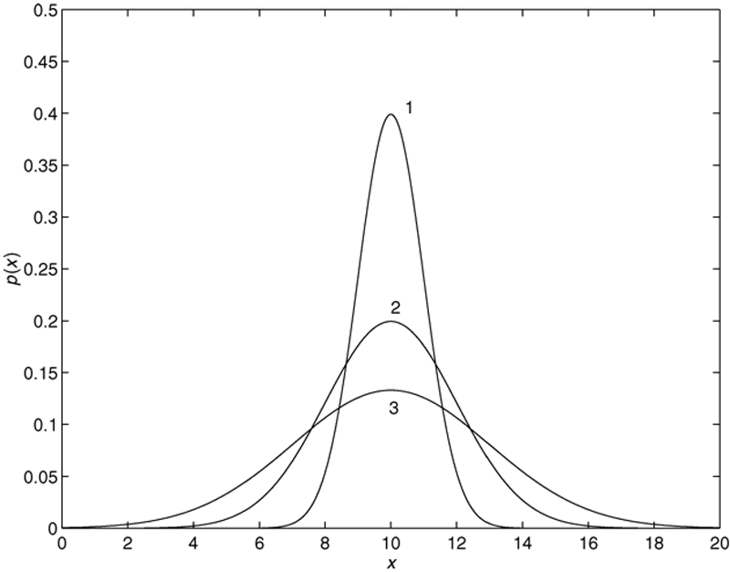
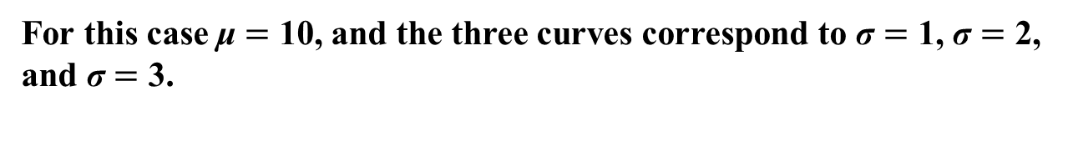
The Effect on the Normal Distribution Curve of Increasing σ
For this case μ $=$ 10, and the three curves correspond to σ $=$ 1, σ $=$ 2, and σ $=$ 3.

Slide 19
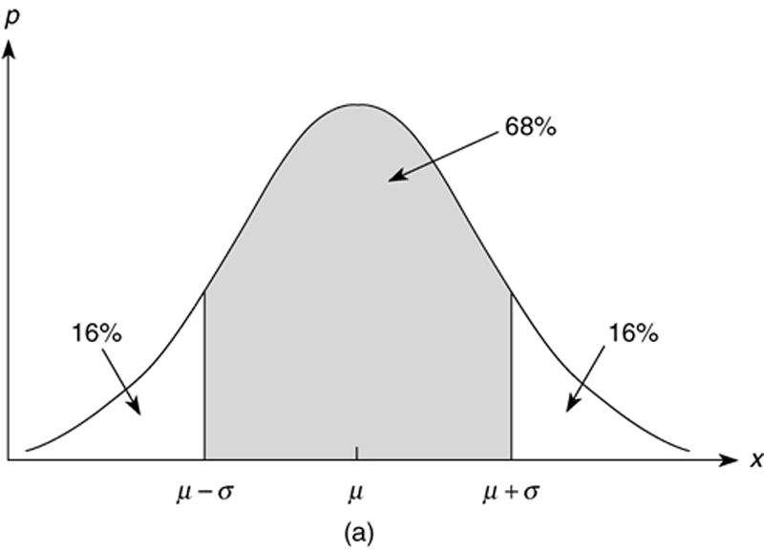
Probability Interpretation of the μ ± σ Limits

Slide 20
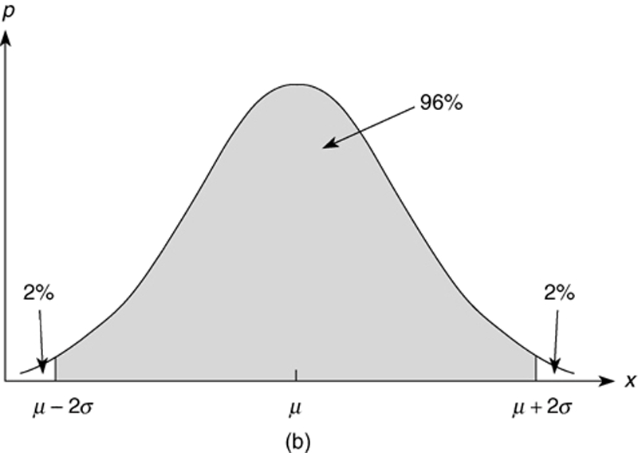
Probability Interpretation of the μ ± 2σ Limits

Slide 21
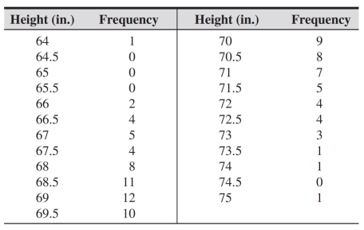
Mean and Standard Deviation of Heights
Statistical analysis of data on human proportions is required in many engineering applications. For example, designers of submarine crew quarters need to know how small they can make bunk lengths without eliminating a large percentage of prospective crew members. Use MATLAB to estimate the mean and standard deviation for the height data given below.

Slide 22
Mean and Standard Deviation of Heights
% Absolute frequency data.
y_abs = [1,0,0,0,2,4,5,4,8,11,12,10,9,8,7,5,4,4,3,1,1,0,1];
binwidth = 0.5;
% Define the bins.
bins = [64:binwidth:75];
% Fill the vector y_raw with the raw data.
% Start with an empty vector.
y_raw = [];
for i = 1:length(y_abs)
if y_abs(i)>0
new = bins(i) *ones(1,y_abs(i));
else
new = [];
end
y_raw = [y_raw,new];
end
% Compute the mean and standard deviation.
mu = mean(y_raw),sigma = std(y_raw)
Results: mu = 69.6 in., sigma = 1.96 in

Slide 23


Probability Calculations with the Error Function erf
The probability that the random variable 𝑥 is less than or equal to b is written as P(x ≤ b) if the outcomes are normally distributed.
The probability that the random variable 𝑥 is no less than a and no greater than b is written as P(a≤ x ≤ b). It can be computed as follows:

Slide 24
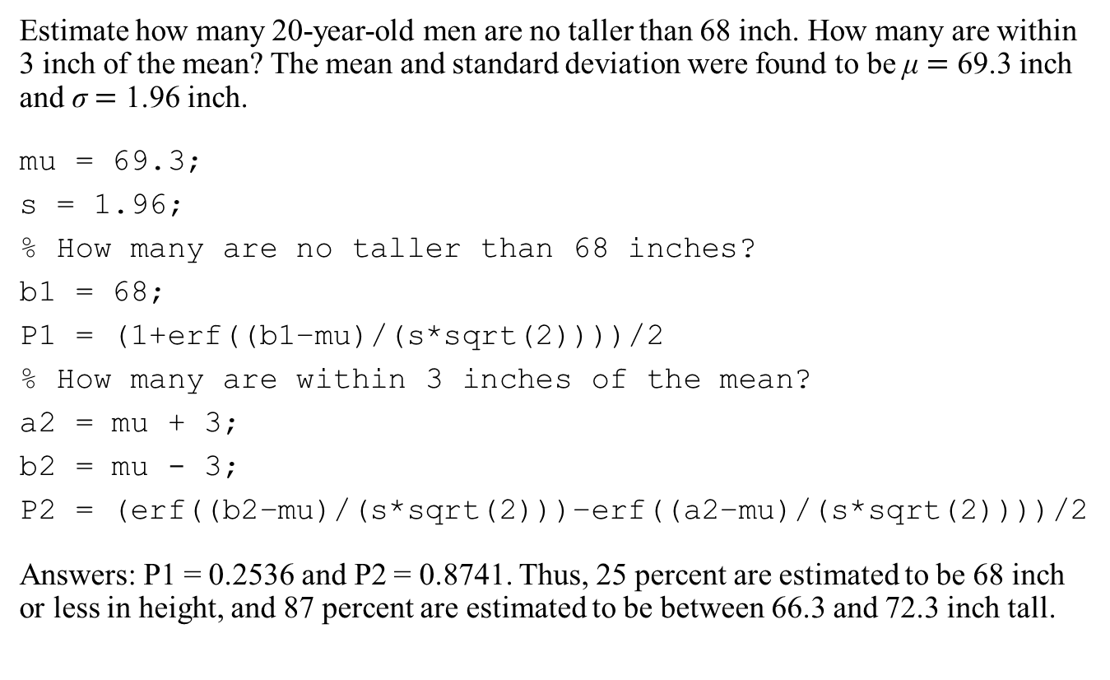
Estimation of Height Distribution
Estimate how many 20-year-old men are no taller than 68 inch. How many are within 3 inch of the mean? The mean and standard deviation were found to be μ $=$ 69.3 inch and σ $=$ 1.96 inch.
mu = 69.3;
s = 1.96;
% How many are no taller than 68 inches?
b1 = 68;
P1 = (1+erf((b1−mu)/(s*sqrt(2))))/2
% How many are within 3 inches of the mean?
a2 = mu + 3;
b2 = mu - 3;
P2 = (erf((b2−mu)/(s*sqrt(2)))−erf((a2−mu)/(s*sqrt(2))))/2
Answers: P1 = 0.2536 and P2 = 0.8741. Thus, 25 percent are estimated to be 68 inch or less in height, and 87 percent are estimated to be between 66.3 and 72.3 inch tall.

Slide 25
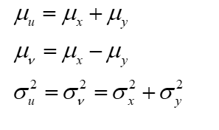
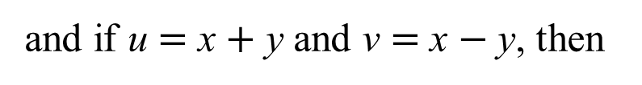
Sums and Differences of Random Variables
It can be proved that the mean of the sum (or difference) of two independent normally distributed random variables equals the sum (or difference) of their means, but the variance is always the sum of the two variances. That is, if x and y are normally distributed with means
and
and
variances
and
and if u $=$ x $+$ y and ν $=$ x $−$ y, then

Slide 26
Random Number Generation
The MATLAB function rand generates random numbers uniformly distributed over the open interval (0,1) using an algorithm called a random number generator, which requires a “seed” number to start. Type rand to obtain a single random number in the open interval (0,1). Typing rand again generates a different number. For example,
>>rand
ans =
0.7502
>>rand
ans =
0.5184

Slide 27
Random Number Generation
For example, the following script makes a random choice between two equally probable alternatives and computes the statistics for 100 simulated tosses of a fair coin.
% Simulates multiple tosses of a fair coin.
heads = 0;
tails = 0;
for k = 1:100
if rand < 0.5
heads = heads + 1;
else
tails = tails + 1;
end
end
heads
tails

Slide 28
Random Number Generation
Every time MATLAB starts, the generator is reset to the same state. Therefore, a rand command gives an identical result every time it is executed immediately following startup, and you will see the same sequence you saw in a previous startup.
To avoid getting the same random number when MATLAB restarts, use the command rng(‘shuffle’) before calling rand. This initializes the generator based on the current time given by the computer’s CPU clock. To repeat a result obtained at startup without restarting, reset the generator to the startup state by using rng(‘default’). For example,
>>rand
ans =
0.7502
>>rng(‘default’)
>>rand
ans =
0.7502

Slide 29
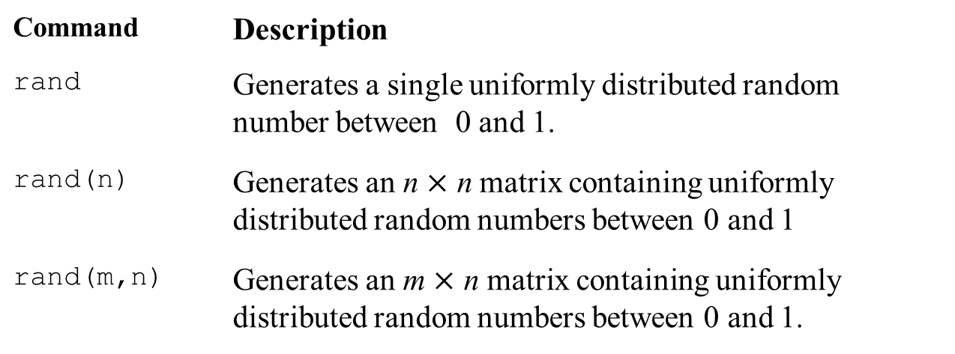
Extended Syntax of the rand Function
Command | Description
rand | Generates a single uniformly distributed random number between 0 and 1.
rand(n) | Generates an n $×$ n matrix containing uniformly distributed random numbers between 0 and 1
rand(m,n) | Generates an m $×$ n matrix containing uniformly distributed random numbers between 0 and 1.

Slide 30
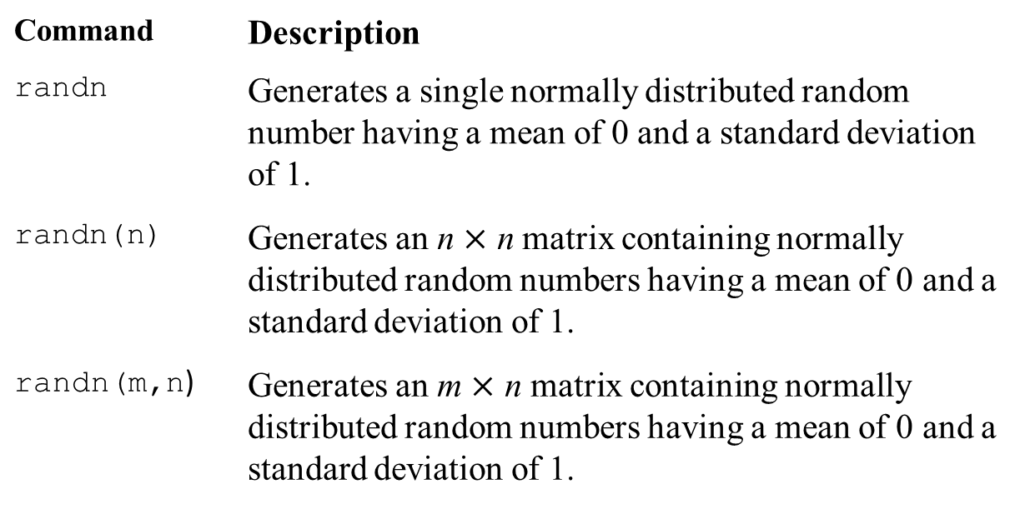
Normally Distributed Random Numbers
Command | Description
randn | Generates a single normally distributed random number having a mean of 0 and a standard deviation of 1.
randn(n) | Generates an n $×$ n matrix containing normally distributed random numbers having a mean of 0 and a standard deviation of 1.
randn(m,n) | Generates an m $×$ n matrix containing normally distributed random numbers having a mean of 0 and a standard deviation of 1.

Slide 31
Example
Write a script file to play a simple number guessing game as follows. The script should generate a random integer in the range 1, 2, 3, . . . , 14, 15. It should provide for the player to make repeated guesses of the number, and it should indicate if the player has won or give the player a hint after each wrong guess. The responses and hints are as follows:
■ “You won” and then stop the game.
■ “Very close” if the guess is within 1 of the correct number.
■ “Getting close” if the guess is within 2 or 3 of the correct number.
■ “Not close” if the guess is not within 3 of the correct number.
Use rng('shuffle') to seed the random number generator based on the current time

Slide 32
Example - Solution
clear
rng('shuffle')
x = randperm(15); number = x(1); k = 0;status = 0;
disp('You will have 14 attempts to guess a number from 1 to 15.')
while(k < 14)&(status == 0)
k = k+1; Turn = k
guess = input('Enter your guess (1 to 15)')
diff = abs(guess-number);
if diff == 0
disp('You won!')
status = 1;
elseif diff > 3
disp('Not close.')
status = 0;
Else
status = 0;
if (diff == 2)|(diff == 3)
disp('Getting close.')
Else
disp('Very close.')
End
end
end
if k >= 14
disp('You have no more guesses left.')
Else
disp('The number of guesses you took was')
disp(k)
end

Slide 33
Example – Solution Cont’d
clear
rng('shuffle')
x = randperm(15); number = x(1); k = 0;status = 0;
disp('You will have 14 attempts to guess a number from 1 to 15.')
While (k < 14)&(status == 0)
k = k+1; Turn = k
guess = input('Enter your guess (1 to 15)')
diff = abs(guess-number);
if diff == 0
disp('You won!')
status = 1;
elseif diff > 3
disp('Not close.')
status = 0;
else
status = 0;
if (diff == 2)|(diff == 3)
disp('Getting close.')
else
disp('Very close.')
end
end
end
if k >= 14
disp('You have no more guesses left.')
else
disp('The number of guesses you took was’)
disp(k)
end

Slide 34
Normally Distributed Random Numbers
You can generate a sequence of normally distributed numbers having a mean μ and standard deviation σ from a normally distributed sequence having a mean of 0 and a standard deviation of 1. You do this by multiplying the values by σ and adding μ to each result.
Thus, if x is a random number with a mean of 0 and a standard deviation of 1, use the following equation to generate a new random number y having a standard deviation of σ and a mean of μ.
y = σx + μ

Slide 35
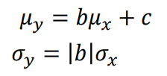
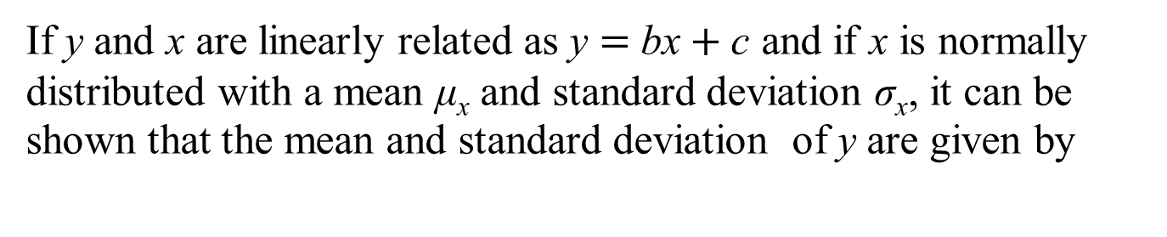
Normally Distributed Random Numbers
If y and x are linearly related as y $=$ bx $+$ c and if x is normally distributed with a mean μ_{x} and standard deviation σ_{x}, it can be shown that the mean and standard deviation of y are given by
For example, to generate a vector y containing 2000 random numbers normally distributed with a mean of 5 and a standard deviation of 3, you type
y = 3*randn(1,2000) + 5.

Slide 36
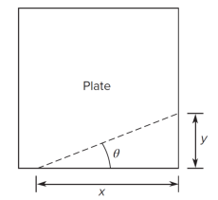


Example to Determine the Statistical Distribution of a Nonlinear Function θ $=$ atan(y/x)
Suppose you must cut a triangular piece off the corner of a square plate by measuring the distances 𝑥 and 𝑦 from the corner. The desired value of 𝑥 is 10 𝑖𝑛., and the desired value of 𝜃 is 20°. This requires that 𝑦 = 3.64 𝑖𝑛. We are told that measurements of 𝑥 and 𝑦 are normally distributed with means of 10 and 3.64, respectively, with a standard deviation equal to 0.05 𝑖𝑛. Determine the standard deviation of 𝜃 and plot the relative frequency histogram for 𝜃.

Slide 37

Determine the Statistical Distribution of the Nonlinear Function θ $=$ atan(y/x)
s = 0.05; % standard deviation of x and y
n = 8000; % number of random simulations
x = 10 + s*randn(1,n);
y = 3.64 + s*randn(1,n);
theta = (180/pi) *atan(y./x);
mean_theta = mean(theta)
sigma_theta = std(theta)
xp = 19:0.1:21;
histogram(theta,xp,‘Normalization’,‘probability’),...
xlabel(‘Theta (degrees)’),...
ylabel(‘Relative Frequency’)

Slide 38
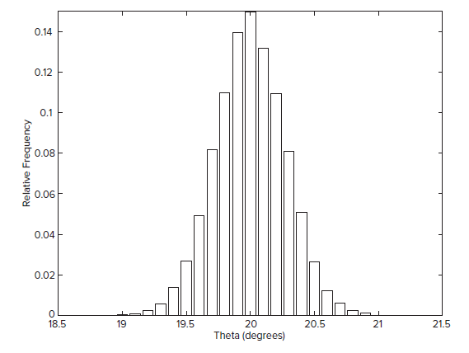

Determine the Statistical Distribution of the Nonlinear Function θ $=$ atan(y/x)
From the histogram we can calculate that approximately 65 percent of the values of θ lie between 19.8 and 20.2. This range corresponds to a standard deviation of 0.2°, not 0.273° as calculated from the simulation data.

Slide 39
Generating Random Integers
To simulate some games, such as dice, you must be able to generate only random integers. You can do this with the randperm(n) function, which generates a row vector containing a random permutation of the integers from 1 to n inclusive.
For example, randperm(6) might generate the vector [3 2 6 4 1 5], or some other permutation of the numbers from 1 to 6. Note that randperm calls rand and therefore changes the state of the generator.
The extended syntax is randperm(n,k). This generates a row vector containing k unique integers selected randomly from 1 to n inclusive.

Slide 40
Generating Random Integers
The function randi([a,b],[m,n]) returns an m-by-n matrix containing random integer values between a and b. Typing randi(imax) returns a scalar between 1 and imax.
For example,
>> randi(20,[1,5])
ans =
1 7 3 9 19 16
>>randi([5,20],[1,5])
ans =
5 12 11 17 17
>> randi(6)
ans =
3

Slide 41
Generating Random Integers
Note that randperm returns unique integers, whereas the integer values returned by randi may be repeated
For example, randperm(6) might generate the vector [3 2 6 4 1 5], or some other permutation of the numbers from 1 to 6.
Whereas randi(6,[1,6]) might generate [1 6 3 5 2 5].

Slide 42
Linear Interpolation with the interp1 Function
If x_int is a vector containing the value or values of the independent variable at which we wish to estimate the dependent variable y, then typing interp1(x,y,x_int) produces a vector the same size as x_int containing the interpolated values of y that correspond to x_int. The values in x must be in ascending order, and the values in the interpolation vector x_int must lie within the range of the values in x.
For example, estimate the values of y at x = 8 and x = 10.
>>x = [7, 9, 11, 12]; y = [49, 57, 71, 75];
>>x_int = [8, 10];
>>y_int = interp1(x,y,x_int)
y_int =
53
64

Slide 43
Linear Interpolation with the interp1 Function
The interp1 function can interpolate in a table of values by defining y to be a matrix instead of a vector. Suppose that we have temperature measurements at three locations and the measurements at 8 and 10 a.m. are missing. The data is:
Time | Loc 1 | Loc 2 | Loc 3
7 a.m. | 49 | 52 | 54
9 a.m. | 57 | 60 | 61
11 a.m. | 71 | 73 | 75
12 noon | 75 | 79 | 81
Estimate of the temperatures at 8 and 10 a.m. at each location.

Slide 44
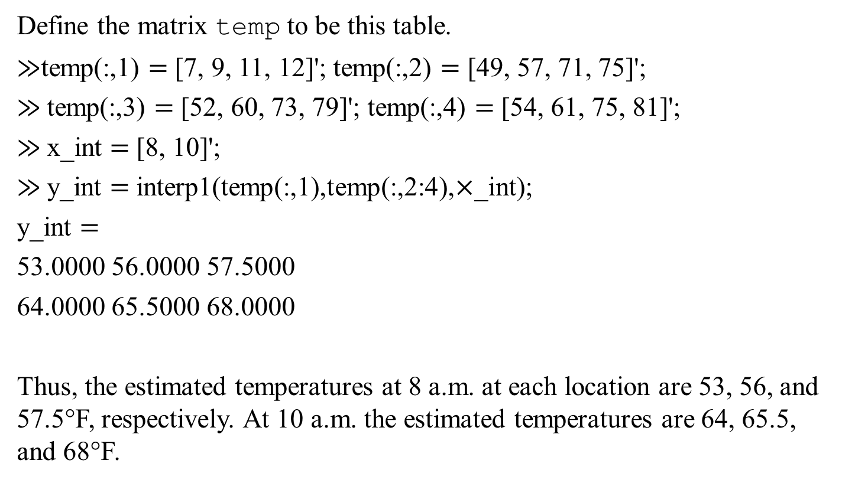
Example: Linear Interpolation
Define the matrix temp to be this table.
$≫$temp(:,1) $=$ [7, 9, 11, 12]'; temp(:,2) $=$ [49, 57, 71, 75]';
$≫$temp(:,3) $=$ [52, 60, 73, 79]'; temp(:,4) $=$ [54, 61, 75, 81]';
$≫$x_int $=$ [8, 10]';
$≫$y_int $=$ interp1(temp(:,1),temp(:,2:4),$×$_int);
y_int $=$
53.0000 56.0000 57.5000
64.0000 65.5000 68.0000
Thus, the estimated temperatures at 8 a.m. at each location are 53, 56, and 57.5°F, respectively. At 10 a.m. the estimated temperatures are 64, 65.5, and 68°F.

Slide 45
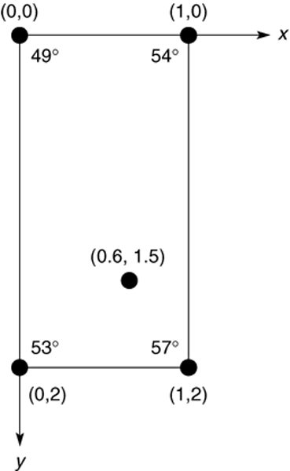
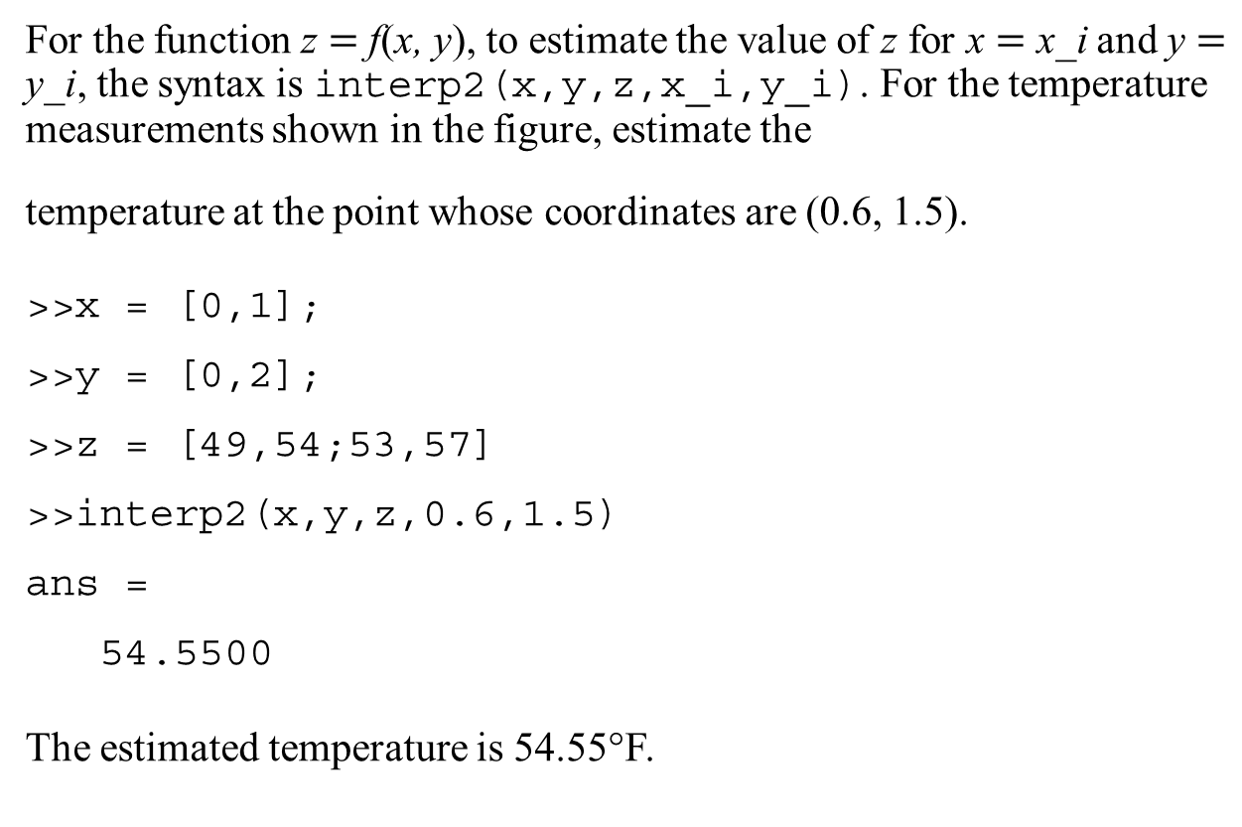
Two-Dimensional Interpolation
For the function z $=$ f(x, y), to estimate the value of z for x $=$ x_i and y $=$ y_i, the syntax is interp2(x,y,z,x_i,y_i). For the temperature measurements shown in the figure, estimate the
temperature at the point whose coordinates are (0.6, 1.5).
>>x = [0,1];
>>y = [0,2];
>>z = [49,54;53,57]
>>interp2(x,y,z,0.6,1.5)
ans =
54.5500
The estimated temperature is 54.55°F.

Slide 46
Spline Interpolation
• High-order polynomials interpolation can exhibit undesired behavior between the data points, and this can make them unsuitable for interpolation.
• A widely used alternative procedure is to fit the data points using a lower-order polynomial between each pair of adjacent data points. This method is called spline interpolation
• The splines used by illustrators to draw a smooth curve through a set of points.
• Spline interpolation obtains an exact fit that is also smooth. The most common procedure uses cubic polynomials, called cubic splines

Slide 47
Cubic-spline Interpolation
If the data are given as 𝑛 pairs of (𝑥, 𝑦) values, then 𝑛 − 1 cubic
polynomials are used. Each has the form
For 𝑥_{𝑖} ≤ 𝑥 ≤ 𝑥_{𝑖+1} and 𝑖 = 1, 2, . . . , 𝑛 − 1. The coefficients 𝑎_{𝑖} , 𝑏_{𝑖} , 𝑐_{𝑖} and 𝑑_{𝑖}
for each polynomial are determined so that the following three
conditions are satisfied for each polynomial:
1. The polynomial must pass through the data points at its endpoints at 𝑥𝑖 and 𝑥𝑖+1.
2. The slopes of adjacent polynomials must be equal at their common data point.
3. The curvatures of adjacent polynomials must be equal at their common data point.

Slide 48
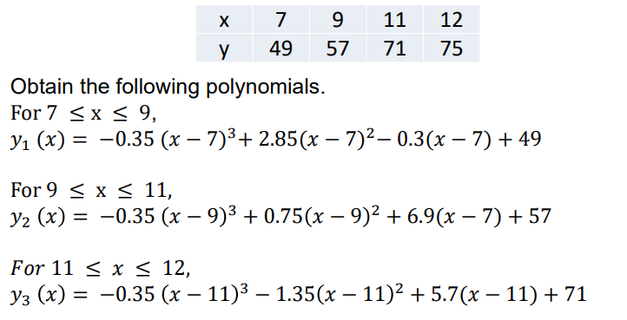
Example: Cubic-spline Interpolation
A set of cubic splines for the temperature data given earlier follows. (y represents the temperature values, and x represents the hourly values). The data are repeated here

Slide 49
Cubic-Spline Interpolation
Cubic-spline interpolation The following session produces and plots a cubic-spline fit, using an increment of 0.01 in the x values.
x = [7,9,11,12]; y = [49,57,71,75];
x_int = 7:0.01:12;
y_int = spline(x,y,x_int);
plot(x,y, ‘o’,x,y,‘--’,x_int,y_int),...
xlabel(‘Time (hr)’), ...
ylabel(‘Temperature (deg F)’),...
title(‘Temperature Measurements …
at a Single Location’),...
axis([7 12 45 80])
This produces the figure on the next slide.

Slide 50
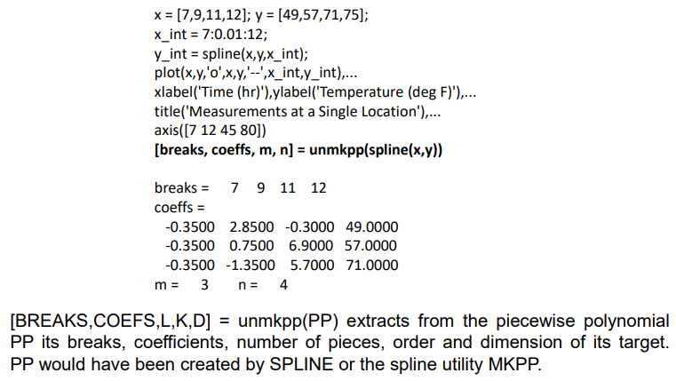
Cubic-Spline Interpolation

Slide 51
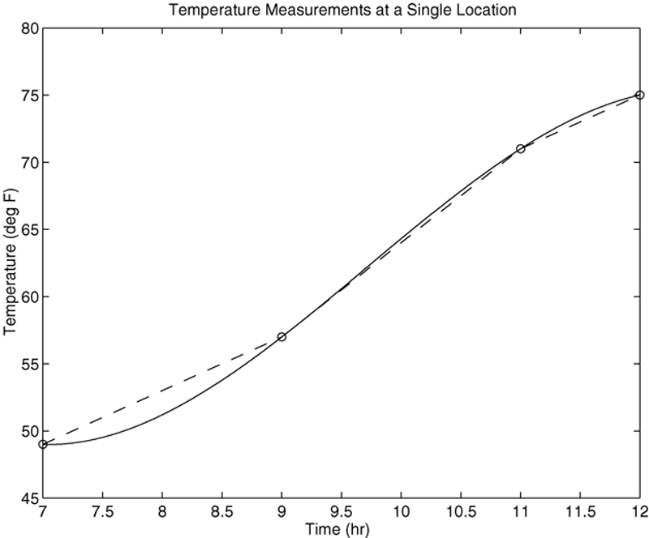
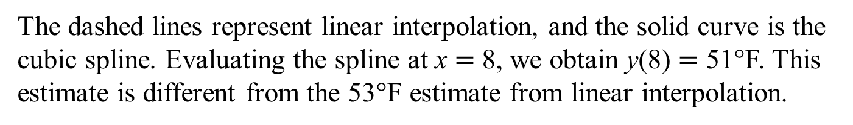
Linear and Cubic-Spline Interpolation
The dashed lines represent linear interpolation, and the solid curve is the cubic spline. Evaluating the spline at x $=$ 8, we obtain y(8) $=$ 51°F. This estimate is different from the 53°F estimate from linear interpolation.

Slide 52
Alternate Form
y_est = interp1(x,y,x_est, method)
Returns a column vector 𝑦_𝑒𝑠𝑡 that contains the estimated values of 𝑦 that correspond to the x values specified in the vector 𝑥_𝑒𝑠𝑡, using interpolation specified by method. The choices for method are ‘nearest’, ‘linear’, 'next', previous',‘spline’, and ‘pchip’.
y_int = spline(x,y,x_int)
Computes a cubic-spline interpolation where x and y are vectors containing the data and x_int is a vector containing the values of the independent variable x at which we wish to estimate the dependent variable y. The result y_int is a vector the same size as x_int containing the interpolated values of y that correspond to x_int.

Slide 53
The pchip Function
Alternate Form
y_int = pchip(x,y,x_int)
Similar to spline but uses piecewise cubic Hermite polynomials for interpolation to preserve shape and respect monotonicity.
[breaks, coeffs, m, n] = unmkpp(spline(x,y))
Computes the coefficients of the cubic-spline polynomials for the data in x and y. The vector breaks contains the x values, and the matrix coeffs is an m × n matrix containing the polynomial coefficients. The scalars m and n give the dimensions of the matrix coeffs; m is the number of polynomials, and n is the number of coefficients for each polynomial.
The unmkpp Function

Slide 54
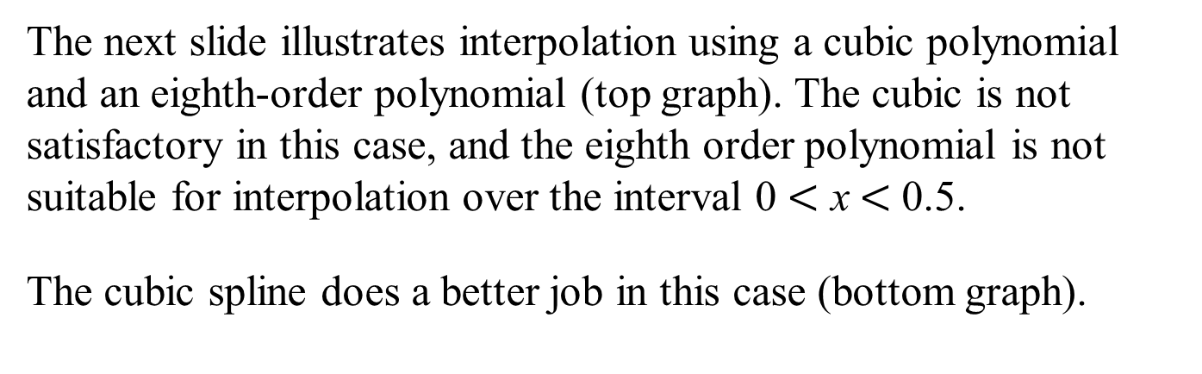
Comparison of Cubic Spline and Eighth-Order Polynomial Interpolation
The next slide illustrates interpolation using a cubic polynomial and an eighth-order polynomial (top graph). The cubic is not satisfactory in this case, and the eighth order polynomial is not suitable for interpolation over the interval 0 $<$ x$<$ 0.5.
The cubic spline does a better job in this case (bottom graph).

Slide 55
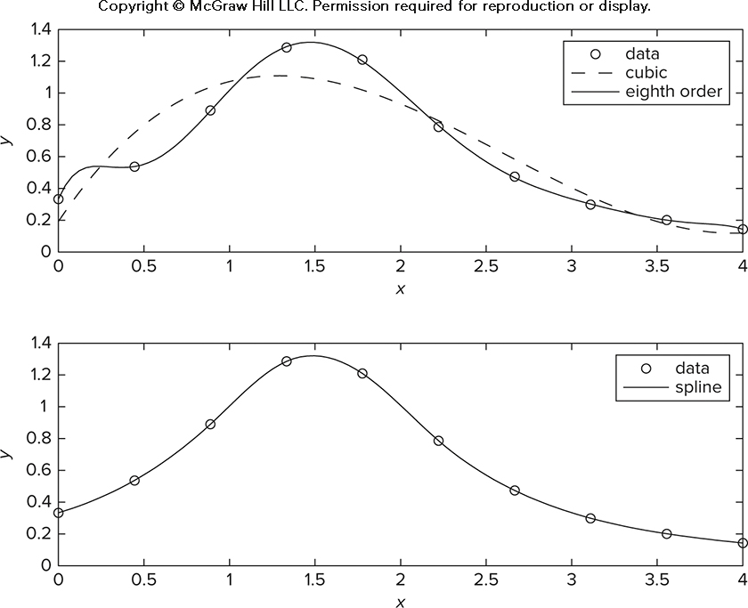
Top: Cubic and eighth-order polynomial interpolation. Bottom: Cubic spline.

Slide 56
Fifth-Order Polynomial versus Cubic Spline
The next slide illustrates interpolation using a fifth order polynomial and a cubic spline (top graph). The cubic spline is better because the fifth order polynomial displays wide variations between the data points.
The pchip polynomial does a better job than the cubic spline in this case (bottom graph).

Slide 57
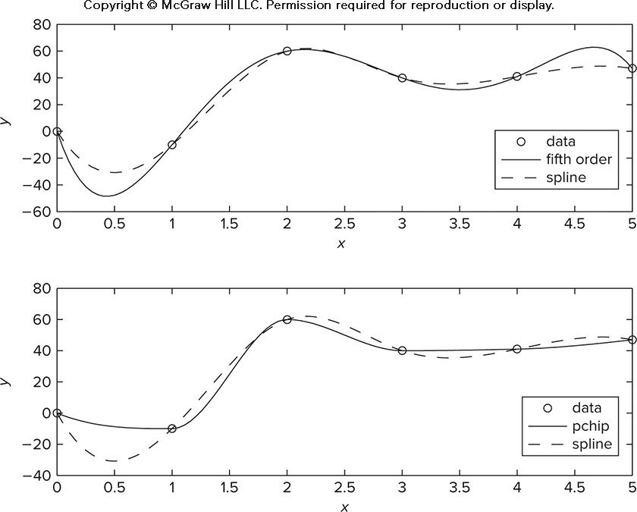
Top: Fifth order polynomial and cubic spline interpolation. Bottom: pchip and cubic spline interpolation.

Slide 58
End of Main Content
© McGraw Hill LLC. All rights reserved. No reproduction or distribution without the prior written consent of McGraw Hill LLC.

